Slide 1
Deploying and Monitoring Custom Solutions
Notes:
This modules focuses on best practice technique of using features and solution packages to deploy site customizations and custom business solutions. First, you will learn how to deploy and manage a solution package as a farm-level solution. The module then introduces you to the new sandboxing architecture in SharePoint Foundation and discusses how sandboxed solutions provide a more reliable way to run custom code within a production environment. You will learn how to configure the Sandboxed Code Service and how to monitor sandboxed solutions running within your farm.

Slide 2
Agenda
Solution Packages and Best Practice Deployment
Deploying and Managing Farm Solutions
Sandboxed Solutions Overview
Uploading and Activating Sandboxed Solutions
Monitoring Sandboxed Solutions

Slide 3
Feature with a capital "F"
Building blocks of SharePoint Sites
Package of functionality
Define and create site elements
Deploy and implement new functionality
Can be turned on or off even after site is created
Use feature “stapling” to modify default behavior of new sites

Slide 4
What can Features do?
Deploy site columns and content types
Define & deploy list templates
Create list instance from templates
Define & Deploy page templates
Deploy web parts
Deploy custom workflow templates
Deploy event receivers to lists
Create new menu items with site

Slide 5
Using Features
Deploy to the farm
Copy files to all servers
\14\templates\features
Install Feature
Done with Windows PowerShell or STSADM
Activate/Deactivate based on scope
Farm
Web Application
Site Collection
Site
Can be hidden
Feature deactivation
Removes functionality
Does not remove data created by feature

Slide 6
SharePoint Solutions
SharePoint development based on solutions
Solution is a CAB file with a *.wsp extension
Solution is a container of files distributed as a unit
Solution contain manifest with instructions for installer
Solutions can be deployed two different ways
As a farm solution
As a sandboxed solution - new in SharePoint 2010

Slide 7
Agenda
Solution Packages and Best Practice Deployment
Deploying and Managing Farm Solutions
Sandboxed Solutions Architecture
Uploading and Activating Sandboxed Solutions
Monitoring Sandboxed Solutions

Slide 8
The SharePointRoot Directory
SharePoint Foundation relies on set of template files
Stored in special directory known as SharePointRoot
SharePointRoot located on file system of each WFE at this path
C:\Program Files\Common Files\Microsoft Shared\Web Server Extensions\14
Farm solutions deploy their files into child directories
Path relative to SharePoint Root | Template file types
/ISAPI | Web Services (.svc, .ashx, .asmx)
/Resources | Resource files (.resx)
/TEMPLATE/ADMIN | Application pages used exclusively in Central Administration
/TEMPLATE/CONTROLTEMPLATES | ASP.NET User Controls (.ascx)
/TEMPLATE/FEATURES | Feature definition files (.xml)
/TEMPLATE/IMAGES | Images (.gif, .jpg and .png)
/TEMPLATE/LAYOUTS | Application pages (.aspx)
/TEMPLATE/LAYOUTS/1033/STYLES | CSS Files (.css)
/TEMPLATE/LAYOUTS/ClientBin | Silverlight components (.xap)
/TEMPLATE/SiteTemplates | Site Definition files (onet.xml)
/TEMPLATE/XML | Custom field type definition files (fdltype*.xml)

Slide 9
Designing and Implementing Features
What is a SharePoint Feature?
Formally known as a “feature definition”
A unit of design and implementation
A building block for creating SharePoint solutions
Features can contain elements
e.g. menu items, links, list types and list instances
Many other element types possible
Features can contain event handlers
Implemented using a feature receiver class
Event handler code can program using SharePoint OM
Notes:
Features can be used to deploy any type of customization:
Web Parts
Application pages
Event handlers
Custom actions
Site columns
Content types
List definitions and list instances
Master pages

Slide 10
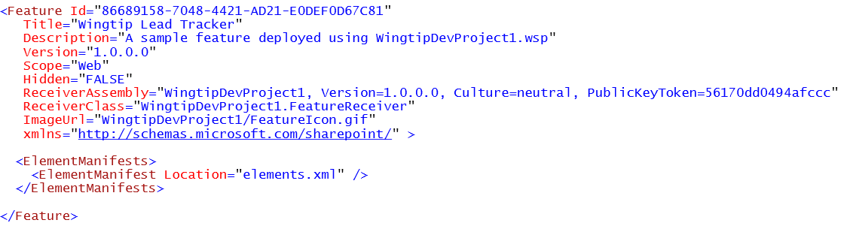
The feature.xml file
feature.xml serves as feature manifest file
Defines attributes for feature definition
Can reference one or more element manifests
Can reference a feature receiver

Slide 11
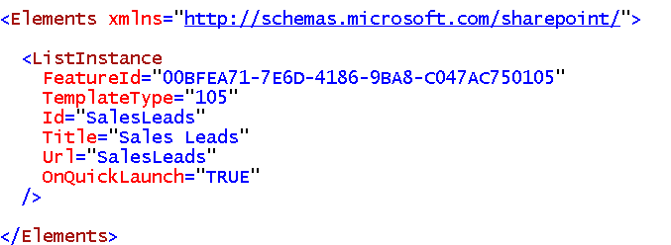
Element Manifest Files
Element manifest contain declarative elements
ListInstance elements creates list during activation
Many other element types available
element manifest can contain many elements
feature.xml file can reference many element manifests

Slide 12
Element Types
Many available element types
List of the most common:
Element Type | Description
PropertyBag | Used to add name-value properties to feature
ListInstance | Used to create a list instance
CustomActionGroup | Used to create a new section for links
CustomAction | Used to create a new link or menu command
HideCustomAction | Used to hide a built-in or custom link or menu command
Module | Used to provision a file from a template file
Field | Used to create a site column
ContentType | Used to create a content type
ContentTypeBinding | Used to add a content type to a list
ListTemplate | Used to create a custom list type
Control | Used to create a delegate control
Workflow | Used to create a workflow template
WorkflowActions | Used to create declarative workflows
WorkflowAssociation | Used to associate a workflow template with a list
FeatureSiteTemplateAssociation | Used to staple a feature to a site definition

Slide 13
Deployment using Solution Packages
What is a solution package?
A mechanism for best practice deployment
Atomic unit of reuse, deployment and versioning
A set of files and manifest with installation instructions
A CAB file with *.wsp extension
What can be deployed via a solution package
Feature definitions
Images
Assemblies
And much more…
Notes:
Features can be deployed to SharePoint using solution packages. A solution package is a *.cab file with extension *.wsp and contains a the files that make up the different features in the solution package.
A solution package also contains a manifest.xml. This file defines the list of features, site definitions, resource files, Web Part files, and assemblies to process.

Slide 14
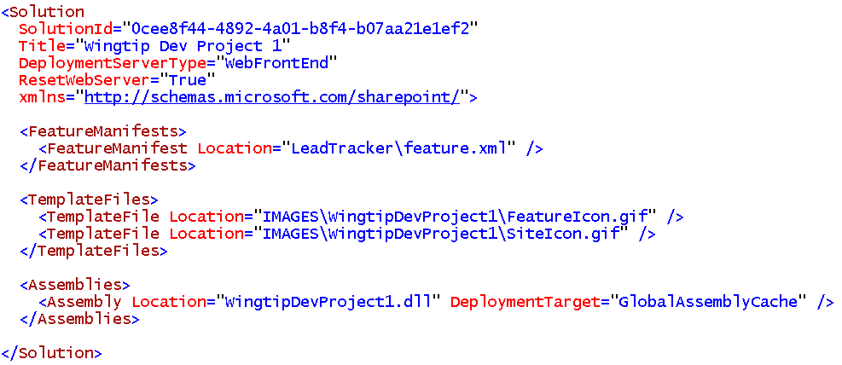
The manifest.xml file
Each Solution Package requires manifest.xml file
Mainly serves as instructions to installer on WFE

Slide 15
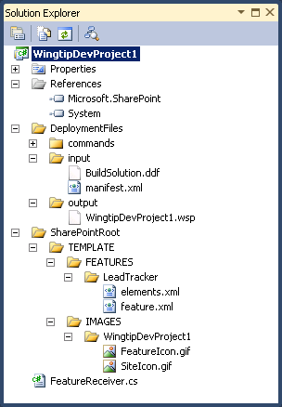
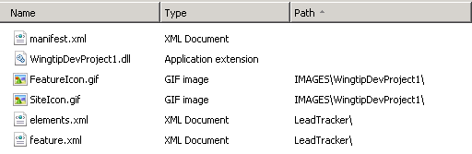
Creating Solution Packages
Can be done using Visual Studio projects
Project folder structure mirrors SharePoint Root
Developer maintains solution manifest (manifest.xml)
Developer creates *.ddf file and use MAKECAB.EXE
Manifest.xml
Instructions
for installer
on WFE
WingtipDevProject1.wsp
.DDF
MAKECAB.EXE
NOTE: The Visual Studio 2010 SharePoint Tools automate the process of generating the *.wsp file and making it transparent to SharePoint developers
Notes:
Solution packages can be created using Visual Studio by creating a simple class library project. The project folder has to reflect the SharePoint root.
The manifest.xml must be created in the root of the project.
Because the solution file is essentially a *.cab file, you can use the makecab.exe tool to create the solution package. The makecab.exe tool takes a pointer to a *.ddf(Diamond Definition File) file, which describes the structure of the *.cab file. In the *.ddffile you declare a standard header and then enumerate, one file per line, the set of files by where they live on disk, separated by where they should live in the *.cab file.

Slide 16
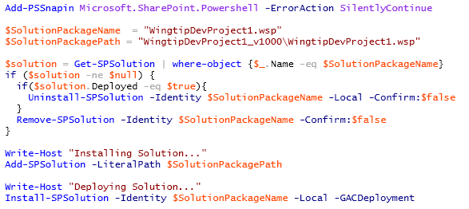
Farm Solution Deployment
Done using Windows PowerShell scripts
Call Add-SPSolution to install solution package this copies *.wsp file to the configuration database
Call Install-SPSolution to deploy solution package this pushes *.wsp file to each WFE and runs installer

Slide 17
Agenda
Solution Packages and Best Practice Deployment
Deploying and Managing Farm Solutions
Sandboxed Solutions Overview
Uploading and Activating Sandboxed Solutions
Monitoring Sandboxed Solutions

Slide 18

SharePoint 3.0’s Challenge
Developers build custom solutions
Administrators can only secure solutions with CAS
Hard to control what is being done in custom code
Biggest cause of SharePoint support cases: custom solutions with code
Developer
Design, build, and test custom solutions
Administrator
Install and monitor custom solutions
Site Collection Owner
Activate and use custom solutions
Notes:
The product SharePoint releasesthe burden on IT departments by allowing end-users to manage the information structure.
This is an important part to the success of SharePoint, the core concept of sites, lists and libraries and provisioning.
However, the real value lies in the customizations that enable you to maximize the potential that sits in the templates provided by SharePoint.
In SharePoint 2007 you still need IT to install and maintain these customizations. This slows down business and impacts IT unnecessarily.

Slide 19
SharePoint 2010 Approach
Developers build custom solutions
Site collection owners deploy, activate and implement the customizations
Administrators leverage resource monitors to check site collection usage
Automatic triggers “turn off” custom solutions in a site collection that are too expensive and taxing on the server
Developer
Design, build, and test custom solutions
Site Collection Owner
Deploy, activate and use custom solutions
Administrator
Monitor custom solutions
Take action when custom solution causes problems
Notes:
SharePoint 2010 allows customizations to be deployed and maintained at the site collection level.
Increasing agility while releasing burden on IT.
Of course there is still IT involvement, but mainly when things go wrong (such as excessive resource usage).

Slide 20
Introducing Sandboxed Solutions
Sandboxed solution: site collection owners can upload to SharePoint
Empowers site collection owners to deploy new functionality w/o involvement of IT
Local/remote development options
Self-regulating and monitored by IT
Limited set of permissions & functionality
Resource quotas established & monitored by IT
Secure: site collection owner is in control
Notes:
Sandboxed solutions allow more custom code deployment flexibility by site collection owners, at the same time putting up guards to protect the server.
Sandboxed solutions execute with limited permissions and functionality. They run under a subset of the SharePoint API.
System resources like memory and CPU cycles are limited by quotas.

Slide 21
Sandboxed Solutions Help Enterprises
Sandboxed solutions are important because
Solve SharePoint hosting issues in corporate environments
Hosted environments much easier to manage
Reduces time to deploying custom solutions
Removing process of getting code approved and deployed by IT
Improves stability of SharePoint servers
Now badly performing code isolated to site collection rather than potentially bringing down an entire server
Notes:
Site collections are empowered to deploy custom code that will run within a sandbox thus not hurt the system.
No longer need to get admins involved in deployment.
Solutions that risk the stability of the farm can be shut down.

Slide 22
Overview of the Sandbox
Allows a subset of the full capabilities in the SharePoint API
Secure – enforcing the sandbox
Execute in a partially trusted environment
Code executes in a special service process
Subject to CAS
Validation framework
Provides way to do custom farm wide validation for the deployed packages
Each solution is isolated to its site collection
Notes:
Sandboxed solutions run under a subset of the SharePoint API.
Sandboxed solutions run in a separate process that is restricted by .NET Code Access Security policy.

Slide 23
Agenda
Solution Packages and Best Practice Deployment
Deploying and Managing Farm Solutions
Sandboxed Solutions Overview
Uploading and Activating Sandboxed Solutions
Monitoring Sandboxed Solutions

Slide 24
Sandboxed Solution Lifecycle
Installation
Upload into Solution Gallery
Activation
Auto-activates features
Deactivation
Inert operation, extended by developer
Web Parts no longer execute
Deletion
Solution is validated upon installation
Notes:
The way people install and interact with a sandboxed solution is similar to normal solutions, but slightly automated.
Important concept to hit is the fact that solutions get validated before they are allowed to be installed, and that you can extend this validation.
After installation the solution is activated, which auto-activates features.
Deactivation is a different story. The main thing that is visible are Web Parts executing from the sandbox. They will no longer execute.
If you re-activate the solution the Web Parts will start executing again.
You can change the behavior using feature receivers.

Slide 25
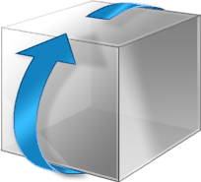





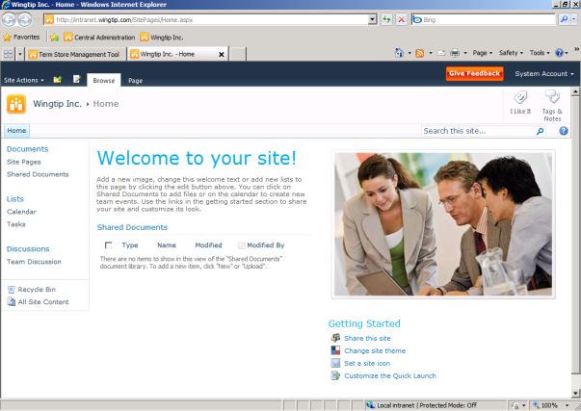



Sandboxed Solutions Process
SPSite.RootWeb
Per-Server AssemblyCache
1
Solution gallery
5
<siteguid>\WebParts.wsp\ WebParts.dll
WebParts.wsp
2
Web Part gallery
6
4
Sandboxed Code Serice
3
7
Notes:
The process of using a custom "bugs" Web Part and solution in a particular site:
The SPSiteadmin uploads a new solution package (*.wsp) into the Solution Gallery of the SPSite.
The SPSiteadmin "activates" the solution. This activates the features within the solution. Web Part files are copied into the Web Part gallery. As part of the activation, solution is validated using the validation framework. Custom validator can be added for example to check that only solutions signed with certain key can be activated. Customers and partners can develop their own validators based on their needs.
Some time later, a user decides to add a Web Part to their home page. They go into Web Part edit mode, and click "Add a Web Part". They notice the additional Web Part options, and click Add.
SharePoint now checks to see if the bugs.dll file, which backs this Web Part, is installed into the assembly cache. It is not.
The assembly is faulted into the assembly cache; it is extracted and copied from the solution file to temporary folder in disk and loaded to memory (disk is cleaned immediately). Now the Web Part is about to be used.
It is loaded into Sandbox Code service host.
Processes deliver the Web Part to be executed to the service.

Slide 26



Sandbox and Code Access Security
AspNetHostingPermission, Level=Minimal
SharePointPermission, ObjectModel=true
SecurityPermission, Flags=Execution
Sandbox
My.dll
User Code
wss_usercode.config
Other.dll
System.dll
SharePoint.dll
Framework Code
Full Trust
SharePoint OM
API Block List
Notes:
Code is executed in a sandbox protected through CAS.
There are two general policies:
The first applies to Microsoft SharePoint DLLs, giving them full-trust (including the Subset OM),
The other applies to all other code. You are given very strict permissions.
In order to shield from lurking dangers in the SharePoint object model, SharePoint has a concept of a API Block List that allows further restrictions on the APIs a sandboxed piece of code can call.

Slide 27
Agenda
Solution Packages and Best Practice Deployment
Deploying and Managing Farm Solutions
Sandboxed Solutions Overview
Uploading and Activating Sandboxed Solutions
Monitoring Sandboxed Solutions

Slide 28
Sandbox Solution Monitoring
Site collection quotas specify the warning and hard limits for number of resources that can be used per day
Sum of resource measures are taken across solutions deployed to site collection
i.e.: add up CPU Points for all solutions
Max of resource utilization measures checked against site collection quota to determine if it should be throttled / blocked
Notes:
Resource monitors keep sandbox solutions from over taxing the server.
The SUM of all resource measures is the number applied to the quota.
The MAX of all resource measures is used to determine if the sandbox should be turned off for a given solution for the rest of the day.

Slide 29
Monitored Resources
Metric Name | Description | Units | Resources Per Point | Hard Limit
AbnormalProcessTerminationCount | Process gets abnormally terminated | Count | 1 | 1
CPUExecutionTime | CPU exception time | Seconds | 3,600 | 60
CriticalExceptionCount | Critical exception fired | Number | 10 | 3
InvocationCount | Number of times solution has been invoked | Count | N/A | N/A
PercentProcessorTime | Note: # of cores not factored in | Percentage Units of Overall Processor Consumed | 85 | 100
ProcessCPUCycles |  | CPU Cycles | 1E+11 | 1E+11
ProcessHandleCount |  | Windows Handles | 10,000 | 1,000
ProcessIOBytes | (Hard Limit Only) Bytes written to IO | Bytes | 0 | 1E+08
ProcessThreadCount | Number of Threads in Overall Process | Threads | 10,000 | 200
ProcessVirtualBytes | (Hard Limit Only) Memory consumed | Bytes | 0 | 1E+09
SharePointDatabaseQueryCount | SharePoint DB Queries Invoked | Number | 20 | 100
SharePointDatabaseQueryTime | Amount of time spent waiting for a query to be performed | Seconds | 120 | 60
UnhandledExceptionCount | Unhanded Exceptions |  | 50 | 3
UnresponsiveprocessCount | We have to kill the process because it has become unresponsive | Number | 2 | 1
Notes:
Resource Per Point is how much this contributes to the point limit per day for the site collection.
Hard Limit is how much of this resource a solution can use in a single invocation before it is terminated – a maximum use of quota in a single invocation.
Invocation count is used to measure the per-instance cost of a solution for purposes of reporting and assigning to run-time “tiers” for farms that want to separate solutions into multiple different sandbox processes – there is only one by default.

Slide 30
Managing Sandbox Solutions
Configure site collection quotas from Central Administration
Site collection owners can manage and view resource usage from Site Settings » Solution Gallery
PowerShell administration
Get-SPSite | foreach-object {$_.Quota.UserCodeMaximumLevel = 300}
Get-SPSite | foreach-object {$_.Quota.UserCodeWarningLevel = 100}
You can also block completely certain solutions in farm level
Can be managed from Central Admin level
Notes:
Management of sandbox solutions is handled through resource quotas, similar to site quotas.
Scoped at the site collection.
When sandbox goes over it’s resource allocation, all solutions are blocked from executing in the sandbox for remainder of the day.
Management is done through Central Administration or Windows PowerShell.

Slide 31
Solution Validation
Allows for developers to create & register custom code to execute upon solution activation
Multiple validators can be registered with a farm
Scoped at the farm
All validators are applied to all site collections
Installation:
Must be done with custom code
Easiest with a farm-scoped Feature by implementing the activation & deactivation receivers
Scenario: block all solutions that contain assemblies not signed with corporate private key
Notes:
Farm administrators can deploy solution validators to their farm. Such a validator is run when a solution is uploaded to a solution gallery.
If a solution fails validation, and error message is shown to the user and the solution will not be activated.
If a validator is added to the farm after sandboxed solutions have been activated, the validator will be called the next time the sandboxed solution is executed.
A solution validator is a normal SPPersistedObject and needs to be handled as such. The validator is called when it is installed (on all items) and when a solution is installed or changed.
You can write custom validators by inheriting from SPSolutionValidator class.
The validator must be added to the SPUserCodeServiceSolutionValidatorscollection.
A solution validator can be deployed using a Farm level feature or a PowerShell script.

Slide 32
Summary
Solution Packages and Best Practice Deployment
Deploying and Managing Farm Solutions
Sandboxed Solutions Overview
Uploading and Activating Sandboxed Solutions
Monitoring Sandboxed Solutions

